Slide 1
Citadel Oldtown
A modern solution for Book Lovers and GOT Fans

Slide 2
The challenge
For many readers, managing a personal book collection can be overwhelming

Slide 3
The challenge
For many readers, managing a personal book collection can be overwhelming
Issues like keeping track of read vs. unread books, remembering notes, and organizing favorite books often lead to frustration 😠

Slide 4
Current solutions are bad
Existing apps are often too complex, require internet access, or are overloaded with features that distract from core needs 😫

Slide 5

Current solutions are bad
Existing apps are often too complex, require internet access, or are overloaded with features that distract from core needs 😫
Some readers prefer a simple, offline, and lightweight tool for managing their collection 😎

Slide 6
My solution
Introducing Citadel Oldtown
A lightweight, command-line-based tool designed for personal book management
Inspired by the concept of a private library, similar to “The Citadel” from The Game of Thrones

Slide 7
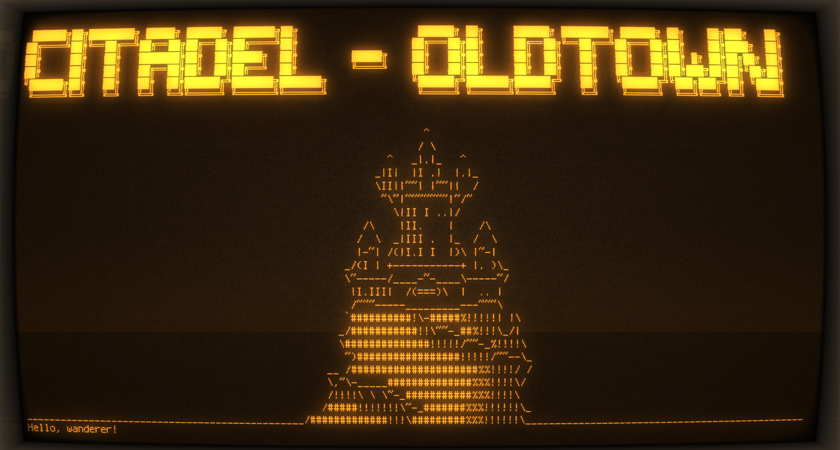
My solution
Introducing Citadel Oldtown

Slide 8
My solution
Key features
Maintain a detailed list of books with status, rating, and personal notes

Slide 9
My solution
Key features
Maintain a detailed list of books with status, rating, and personal notes
Store data offline in a simple, easy-to-access format

Slide 10
Technical overview
Lightweight database
The system uses a JSON file (users.json) as a local, lightweight database to store user data and book collections.

Slide 11
Technical overview
Lightweight database
The system uses a JSON file (users.json) as a local, lightweight database to store user data and book collections.
Core components
User module: Handles user registration and login

Slide 12
Technical overview
Lightweight database
The system uses a JSON file (users.json) as a local, lightweight database to store user data and book collections.
Core components
User module: Handles user registration and login
Book module: Manages book details and operations like adding and viewing books.

Slide 13
Technical overview
Lightweight database
The system uses a JSON file (users.json) as a local, lightweight database to store user data and book collections.
Core components
User module: Handles user registration and login
Book module: Manages book details and operations like adding and viewing books.
Custom Display module: Custom printing module based on GOT and ASCII art

Slide 14
Development process
Planning

Slide 15
Development process
Implementation

Slide 16
Development process
Testing

Slide 17
Thank you
Open for questions and feedback 😎

